Slide 1
VEDIKA INSTRUMENTS
PRIVATE LIMITED
Automation | Instrumentation | Panel Integration
40+
AUTOMATION
PROFILE
Turnkey industrial automation solutions for Pharma,
Automotive, Food & Beverage, Power and Utilities.
YEARS OF ENGINEERING
EXCELLENCE
B-194, 2nd Floor, Green Field Colony, Sector-41, Faridabad – 121010, India
www.vedikainstruments.com • +91 98107 02836 | +91 82877 10277

Slide 2
01
PHARMA
1
API formulation, batch tracking & production management systems
MARKETS
WE SERVE
AUTOMOTIVE
2
Paint shop, assembly line, robotics & machine vision systems
FOOD & BEVERAGE
3
Dairy, sugar, chocolate & cereal plant automation
POWER
Six core industry verticals where our engineering expertise delivers measurable results.
4
Substation control, energy monitoring & load management
UTILITIES
5
WTP / STP, dam & tubewell automation, water monitoring
LOGISTICS
6
Warehouse management, conveyors & smart tracking systems
Vedika Instruments Pvt. Ltd.

Slide 3
02
MARKET-SPECIFIC EXPERTISE
Deep application knowledge built over four decades of plant-floor delivery.
PHARMA
FOOD & BEVERAGE
AUTOMOTIVE
UTILITIES
API formulation
Cereal & chocolate plants
Paint shop automation
Energy & water monitoring
Batch tracking systems
Dairy automation
Assembly shop automation
WTP / STP automation
Production management
Sugar plant automation
Power & free conveyors
Dam automation
Fire protection systems
Robotics automation
Vision systems
Tubewell automation
Warehouse management
Nozzle alignment
IIoT solutions
Downtime analysis
Vedika Instruments Pvt. Ltd.
www.vedikainstruments.com

Slide 4
03
CORE CAPABILITIES
Three integrated pillars that cover the complete automation lifecycle.
01
02
03
INDUSTRIAL AUTOMATION
INDUSTRIAL IIoT
PANEL INTEGRATION
Turnkey industrial automation projects and services, with focused expertise across Food & Beverage, Pharma and Automotive sectors.
Solutions across Energy, Water and Utilities verticals, plus IIoT for Food & Beverage, Pharma and Automotive as per Industry 4.0 standards.
Superior in-house infrastructure facility for all types of panel integration, delivered at exceptional speed and quality.
Vedika Instruments Pvt. Ltd.
www.vedikainstruments.com

Slide 5

01
INDUSTRIAL
AUTOMATION
Robotics, vision systems, control systems and IT — integrated into one production platform.

Slide 6
04
WHAT INDUSTRIAL AUTOMATION MEANS TODAY
From productivity gains to safety, flexibility and product quality.
A BROADER DISCIPLINE
BEYOND PRODUCTIVITY
Use of robots, vision systems, control systems and IT to manage complete industrial processes end to end.
Industrial automation has gone beyond the idea of increased productivity and reduced operating costs.
SAFETY & QUALITY
GLOBAL IMPACT
Today it is about safety, flexibility and consistently increasing product quality at scale.
Industrial automation plays an increasingly important role in the global manufacturing economy.
Vedika Instruments Pvt. Ltd.
www.vedikainstruments.com

Slide 7
05
OUR WORK PHILOSOPHY
A disciplined five-stage delivery method applied to every project.
1
2
3
4
5
UNDERSTAND
›
DESIGN
›
INTEGRATE
›
COMMISSION
›
SUPPORT
Study customer standards, plant conditions and process requirements in detail before design begins.
Develop electrical layouts, SLDs and control architecture using AutoCAD and proven engineering practice.
Build and prewire panels in-house with Tier-1 components under independent quality control.
Site erection, commissioning and handover by our dedicated field commissioning team.
Ongoing operation, maintenance and remote diagnostics through IIoT-enabled monitoring.
Vedika Instruments Pvt. Ltd.
www.vedikainstruments.com

Slide 8
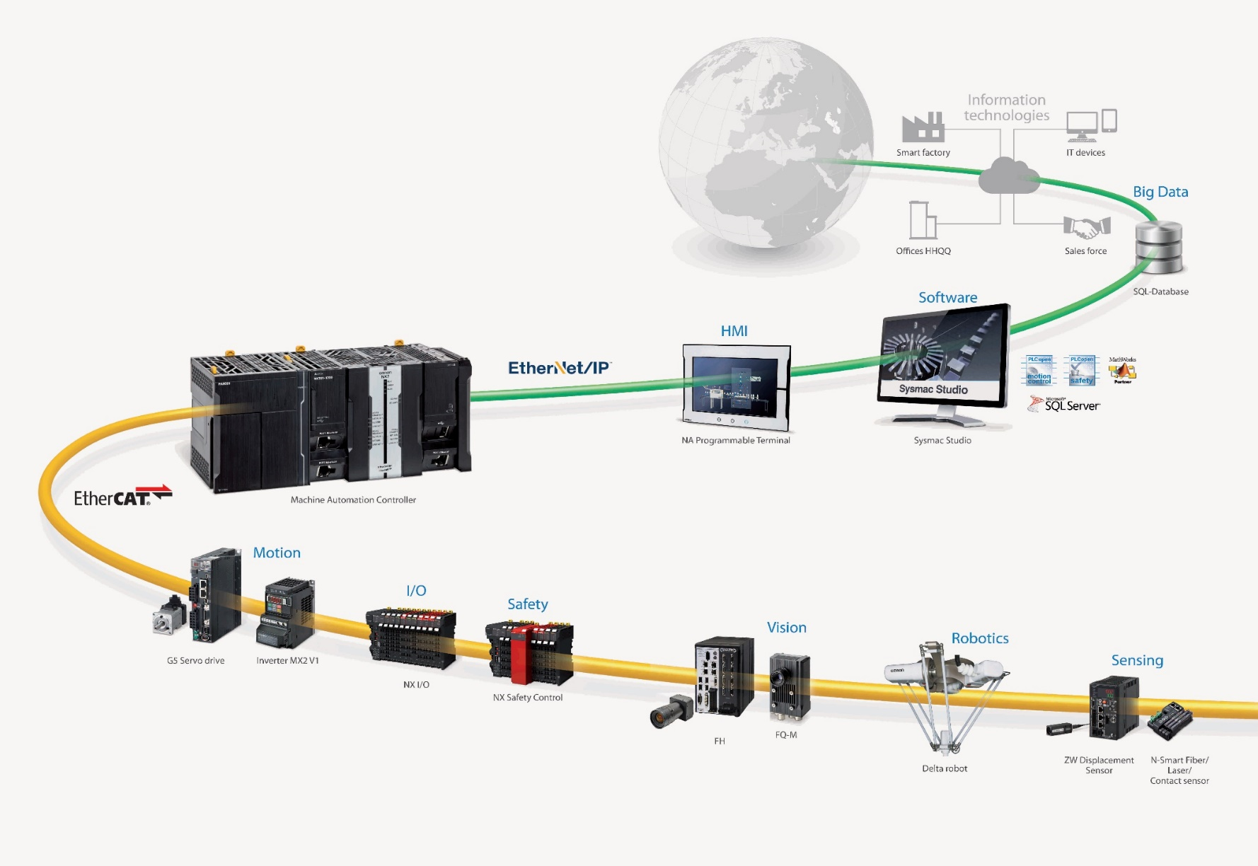
06
SYSMAC — A FULLY INTEGRATED PLATFORM
System for Machine Automation Control: one controller, one network, one software.
ONE MACHINE CONTROLLER
1
Logic plus advanced motion control in one platform.
ONE MACHINE NETWORK
2
EtherCAT control of VFDs, servos, vision, safety and I/O.
ONE CONNECTION
3
EtherNet/IP for local and remote plant access.
ONE SOFTWARE
4
Sysmac Studio: configuration, programming, simulation.
Vedika Instruments Pvt. Ltd.
www.vedikainstruments.com

Slide 9
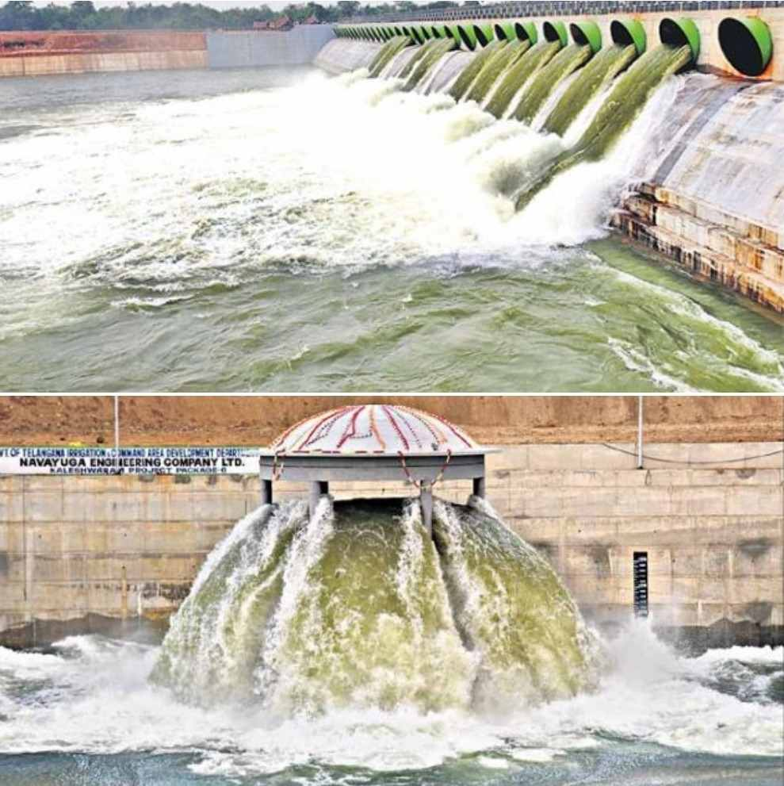
02
WATER, CANAL
& RIVER PROJECTS
Water treatment, tubewell, dam and canal automation with SCADA and cloud connectivity.

Slide 10
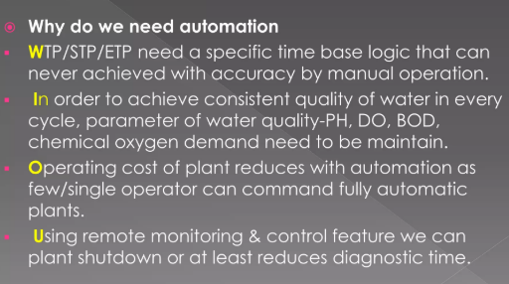
01 / WATER & UTILITIES
PROCESS AUTOMATION
Complete process control architecture built on industrial PLC and SCADA platforms.
Vedika Instruments Pvt. Ltd.

Slide 11
02
WHAT IS A PLC
01
A purpose-built machine control computer that reads digital and analog inputs from field sensors.
WATER & UTILITIES
PRE-ENGINEERED CONTROLLERS
PLC SYSTEMS
02
STP / WTP / ETP controllers ship with all required facilities — only install and start-up on site.
REDUCED PANEL WIRING
03
Built-in auto-manual mode cuts panel switches and wiring — saving cost and space.
Purpose-built machine control computers for reliable, hassle-free plant operation.
SINGLE-SCREEN MONITORING
04
Tank level, pressure, flow and pump status on one LCD screen, in manual and auto mode.
COST EFFECTIVE
05
A very low cost solution delivered through a PLC based control system.
Vedika Instruments Pvt. Ltd.

Slide 12
03
WHAT IS SCADA
01
Operates with coded signals over communication channels to control remote equipment.
WATER & UTILITIES
SCADA OVERVIEW
SINGLE-ENGINEER CONTROL
02
One engineer can view valve, pump and flow meter status — and operate them manually.
FLEXIBLE DATA DISPLAY
Supervisory control and data acquisition with full plant-wide process visualisation.
03
Process data displayed in whatever form the user requires, tailored to the plant.
LARGE-SCALE DATA RECORDING
04
Records and stores very large volumes of historical process data for analysis.
Vedika Instruments Pvt. Ltd.

Slide 13
04
EXISTING PLANT CAPACITY
01
1.5 MGD capacity at 22 hours, with 4 filter beds of 4.20 m × 3.05 m each.
WATER & UTILITIES
NEW PLC ROOM
WATER TREATMENT PLANT
02
New PLC room proposed for centralised control of all valves and digital equipment.
CLARIFLOCCULATORS
03
Two clariflocculators (1W + 1S) ahead of the filter house for proper water mixing.
Automated WTP control with real-time dosing, filtration and quality monitoring.
FILTRATION & DOSING
04
Four sand filter beds purify water, then clear water is dosed with alum / PAC.
BACKWASH SYSTEM
05
Backwash tank with 4 blowers (2W + 2S) clears suspended solids from filter beds.
Vedika Instruments Pvt. Ltd.

Slide 14
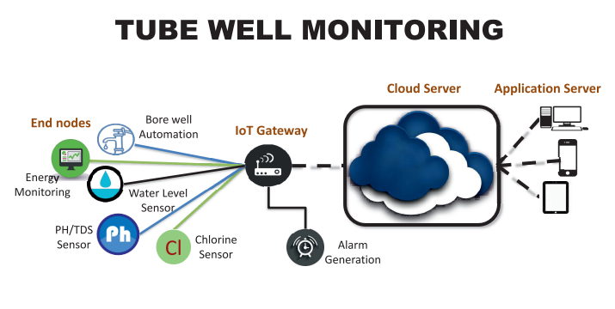
05 / WATER & UTILITIES
TUBEWELL AUTOMATION
Remote tubewell control with level sensing, pump protection and GSM connectivity.
Vedika Instruments Pvt. Ltd.

Slide 15
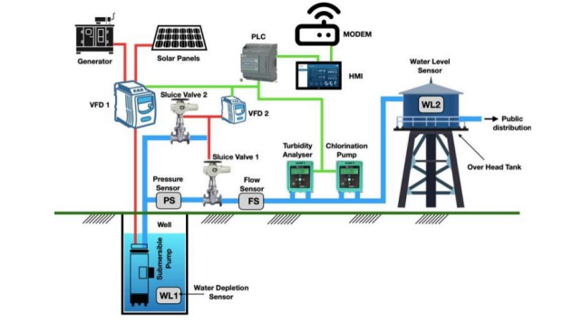
06 / WATER & UTILITIES
TUBEWELL — SYSTEM OVERVIEW
Consolidated overview screen for multi-site tubewell monitoring and control.
Vedika Instruments Pvt. Ltd.

Slide 16
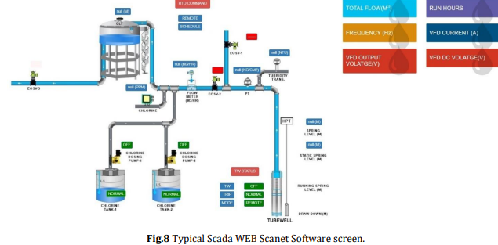
07 / WATER & UTILITIES
SCADA WEB
Browser-based SCADA access for monitoring and control from any location.
Vedika Instruments Pvt. Ltd.

Slide 17
07
HYDROLOGICAL INFORMATION SYSTEM
Three pillars that define a working HIS deployment.
HYDROLOGICAL
INFORMATION
SYSTEM
The science of water in the hydrological cycle — its states, storages and fluxes across location, time and phase. Hygrometry provides the measurement discipline, grounded in repeatability and validation.
Reliability, availability and presentation are the three key features. Information is data manipulated and processed to carry meaning and purpose — it must serve a defined function.
More than a data archive: a logical, structured system where data are collected, checked, stored, compared and combined to deliver information in a form suited to its users.
Vedika Instruments Pvt. Ltd.
www.vedikainstruments.com

Slide 18
08
CANAL & DAM AUTOMATION ARCHITECTURE
Field sensing to cloud SCADA — a complete monitoring chain.
01
02
03
04
FIELD SENSING
DATA ACQUISITION
DATA CENTER
CLOUD SCADA
›
›
›
Gate position sensors and radar level sensors installed at canal, river and dam structures.
Data loggers and RTUs with GSM or PLC connectivity capture and transmit field values.
Centralised aggregation, validation and archival of all incoming field data streams.
SCADA system with cloud feature for remote visualisation, alarms and reporting.
Vedika Instruments Pvt. Ltd.
www.vedikainstruments.com

Slide 19

03
INDUSTRIAL IIoT
& INDUSTRY 4.0
Cloud-connected energy, water, production and remote monitoring platforms.

Slide 20
09
SMART ENERGY MANAGEMENT
Reduce energy cost and carbon footprint through data visibility and automation.
KEY FEATURES
Trends & forecasts
Problem isolation
Performance benchmarking
Diagnostic reports
IT-OT integration
Runtime optimisation
Vedika Instruments Pvt. Ltd.
www.vedikainstruments.com

Slide 21

10
SMART WATER MANAGEMENT
Cloud monitoring of treatment plants, pumping stations, tanks and pipelines.
KEY FEATURES
Water supply analysis
Storage management
Intelligent piping
Dynamic water balance
Automated metering
WTP / STP / ETP digitisation
Vedika Instruments Pvt. Ltd.
www.vedikainstruments.com

Slide 22

11
PRODUCTION MANAGEMENT SYSTEM
Analysis of production activity, resource deployment and safe information management.
KEY FEATURES
Real-time efficiency calculation
Downtime analysis
High-speed production counter
Cloud-based monitoring
Report generation
Vedika Instruments Pvt. Ltd.
www.vedikainstruments.com

Slide 23

12
REMOTE MONITORING & DATA LOGGING
Remote monitoring, central data logging and downtime analysis to Industry 4.0.
KEY FEATURES
Temperature & humidity logging
Pressure & vibration loggers
Air & water quality logging
GSM / GPS integration
Critical alarm generation
Vedika Instruments Pvt. Ltd.
www.vedikainstruments.com

Slide 24
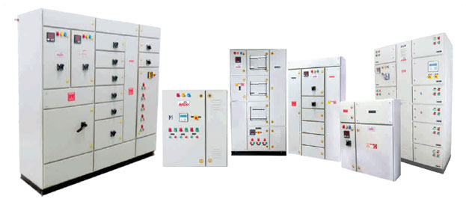
04
PANEL INTEGRATION
& ENGINEERING
In-house manufacture of PLC, MCC, PCC, APFC, VFD panels and distribution boxes.

Slide 25
13
CONTROL PANEL CAPABILITY
Complete design, assembly and quality control under one roof.
Complete design & assembly capability
Independent QC department
In-house automation team
Site commissioning team
Schematic & outline drawings
Completely prewired for easy installation
CNC construction
Safe and reliable operation
Certified panels from IP42 to IP65
Components from Tier-1 vendors
Labelled and colour coded wiring
CAD design (AutoCAD)
Vedika Instruments Pvt. Ltd.
www.vedikainstruments.com

Slide 26
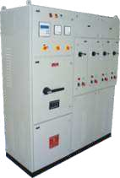
14
PCC — POWER CONTROL CENTER
Supervise and control the voltage of power systems across industrial applications.
SPECIFICATIONS
Up to 6300 Amp current carrying capacity
Short circuit test certificate of 65 KA from CPRI
Integrated with all necessary protections
Meets prevailing industry safety standards
Vedika Instruments Pvt. Ltd.
www.vedikainstruments.com

Slide 27
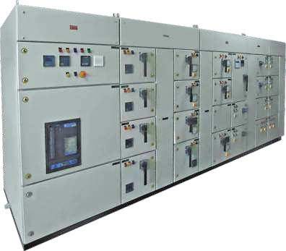
15
APFC — POWER FACTOR CORRECTION
Thyristor or contactor based panels with detuned reactors to counter harmonics.
SPECIFICATIONS
Designed with modularity concept
Very low manual intervention
Avoids power factor penalty
APP / MPP heavy duty capacitor banks
Vedika Instruments Pvt. Ltd.
www.vedikainstruments.com

Slide 28
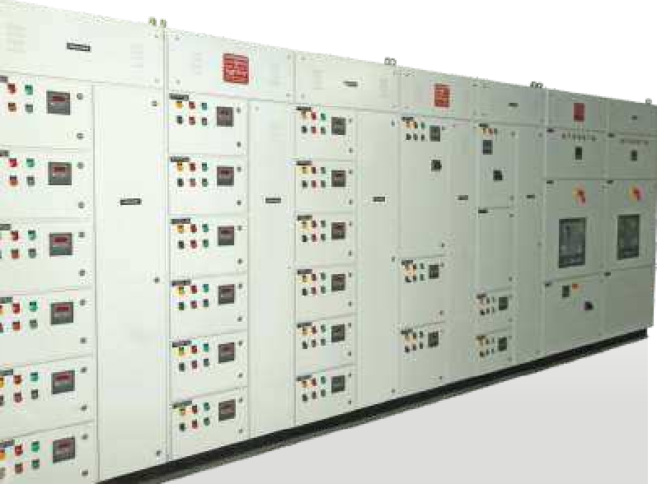
16
MCC — MOTOR CONTROL CENTER
Draw-out and non-draw-out panels with ACB, MCCB, DOL, ATS or star-delta starters.
SPECIFICATIONS
Local / remote / DCS operation
Intelligent MCC communicates with PLC & SCADA
Certified panels from IP42 to IP65
Controls heavy starting currents
Vedika Instruments Pvt. Ltd.
www.vedikainstruments.com

Slide 29
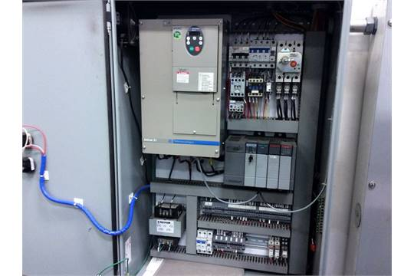
17
VFD — VARIABLE FREQUENCY DRIVE
Speed and torque control by varying input frequency and voltage — saves energy.
SPECIFICATIONS
1–400 HP drive panel range
AHU / chiller & pump / blower control
Remote / local / bypass options
Siemens, ABB, Danfoss, Delta, Mitsubishi
Vedika Instruments Pvt. Ltd.
www.vedikainstruments.com

Slide 30
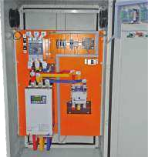
18
SOFT STARTER PANELS
Protects power-transmitting elements during start-up and ramp down.
SPECIFICATIONS
Overload & over current protection
Under / over voltage protection
Graphical display with logical keypad
Advanced setup & status viewing
Vedika Instruments Pvt. Ltd.
www.vedikainstruments.com

Slide 31

19
PLC PANELS
Automatic, efficient and hassle-free plant and machine operation.
SPECIFICATIONS
PLC modules, HMI display, MCB & SMPS
Expandable PLC with SCADA
Redundant PLC for critical operation
Ethernet with SIM for remote control
Vedika Instruments Pvt. Ltd.
www.vedikainstruments.com

Slide 32
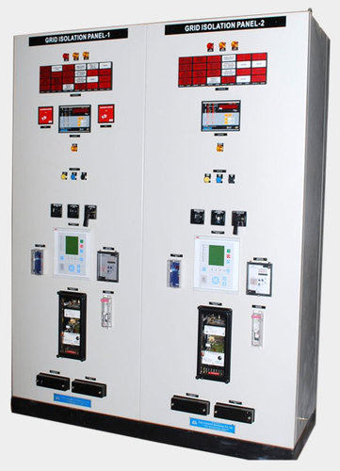
20
INSTRUMENTATION PANELS
Monitors temperature, level, flow and pressure from a single point.
SPECIFICATIONS
Displays pH, ORP, temperature & flow
Annunciator with hooter option
Instant abnormal condition alerts
Immediate corrective control
Vedika Instruments Pvt. Ltd.
www.vedikainstruments.com

Slide 33
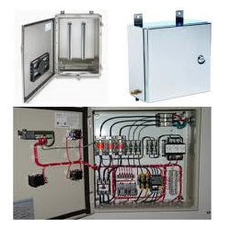
21
JUNCTION BOXES & PDBs
Junction and power distribution boxes — easy to install, maintenance free.
SPECIFICATIONS
SS316 / SS304 / MS with gasketed trims
Flameproof junction boxes
Top / bottom / side cable entry
Aluminium or copper bus option
Vedika Instruments Pvt. Ltd.
www.vedikainstruments.com

Slide 34
22
ENGINEERING & AGGREGATION SERVICES
Design, implementation and supply across the full electrical scope.
ELECTRICAL DESIGN & DEVELOPMENT
ELECTRICAL ENGINEERING
ELECTRICAL ACCESSORIES
Understanding customer standards
LV system design & implementation
Cables, wires & cable trays
Design of electrical layouts
Panel design and construction
Earth strips & switch gear
Creation of SLD
Erection & commissioning
Lighting accessories
AutoCAD electrical layouts
Operation & maintenance
DBs, JBs & panel boards
Vedika Instruments Pvt. Ltd.
www.vedikainstruments.com

Slide 35
GET IN TOUCH
VEDIKA INSTRUMENTS PVT. LTD.
ADDRESS
B-194, 2nd Floor, Green Field Colony, Sector-41, Faridabad – 121010, India
LET'S
BUILD
PHONE
+91 98107 02836 | +91 82877 10277
EMAIL
info@vedikainstruments.com
WEBSITE
www.vedikainstruments.com
Automation • Instrumentation • Panel Integration • Industry 4.0

